Slide 1
MediaBazaar Application
Group 4: Mirela-Cristiana Gherlan
Yash Jagwani
Felix Morenc
Moni Manolov
Tutors: Basjan Schouwenaars
Qin Zhao

Slide 2
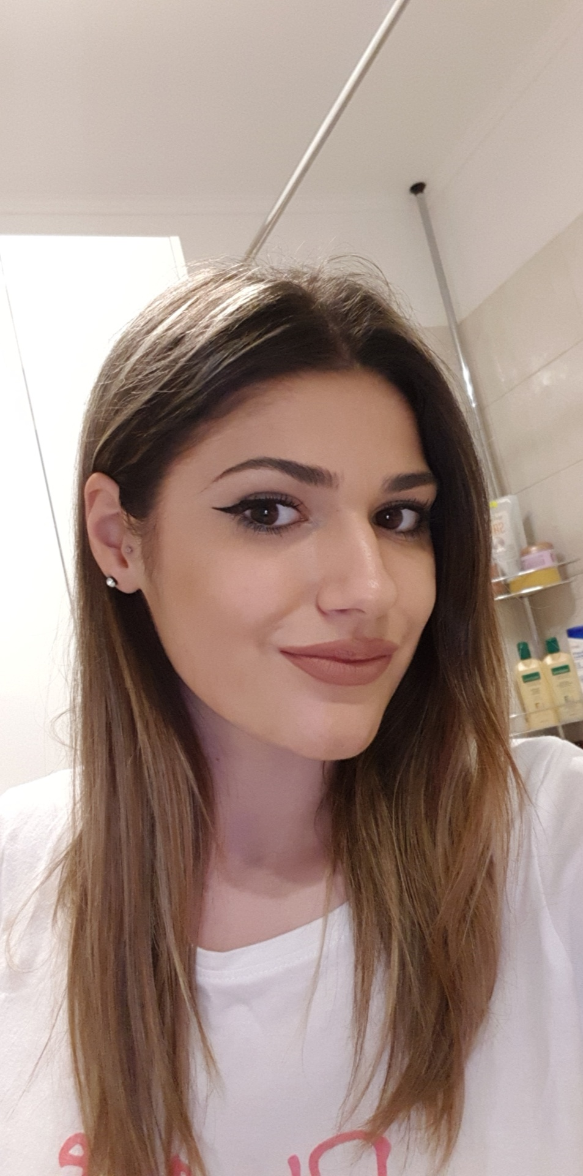
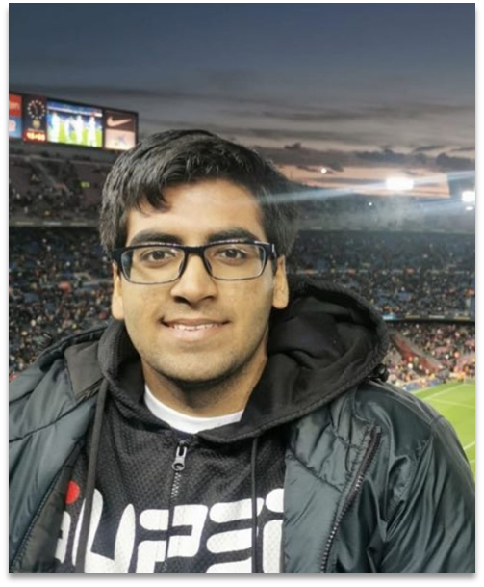
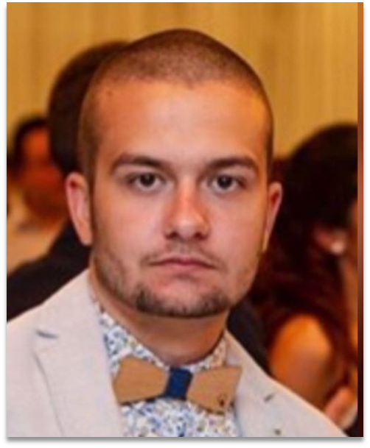
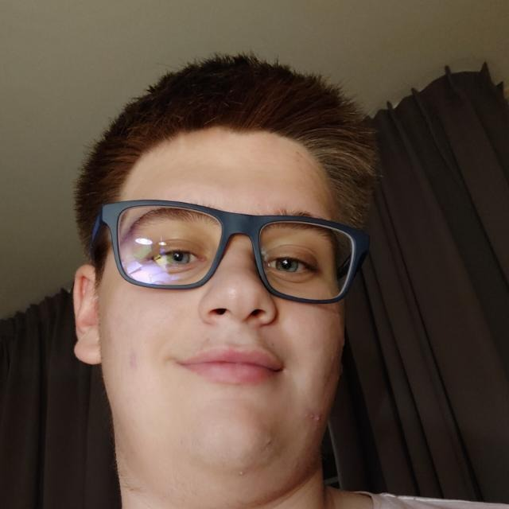
Who are we?
Mirela
Yash
Moni
Felix

Slide 3

What is all about?
MediaBazaar Company is planning to open their very first shop in Eindhoven;
They want us to make an application that can keep track of the products and employees

Slide 4
What we came up with? Our solution
We proposed an implemented Windows Forms C# Application which performs all the functionalities that were requested by our client
We applied the Waterfall Approach to this project

Slide 5

difficulties
We had difficulties in implementing the database
Because of corona virus (covid-19) outbreak recently, the group was not able to contact or work on the project for almost one week. The knowledge needed to finally implement the database and use it correctly was not learnt easily because there was no actual lecture for it. The group had to work off of youtube videos and do trial and error repeatedly until the correct outcome was found.

Slide 6
What we learned our experience
Databases
Bigger group collaborations for a bigger project
The use of a new communication platform ( MS Teams)

Slide 7
Demo

Slide 8
Thank you for your attention! ...and for all the support!

Slide 9

Feedback and questions

